Slide 1


LEARNING STATISTICS IN EXCEL

Slide 2

George Mount
Data Analyst & Educator at Stringfest Analytics
George works as an independent analyst and data analytics educator with the goal to help clients manage their data so they think more creatively. He serves as a technical expert and lead curriculum developer for Thinkful’s data analytics program and is the instructor of the DataCamp course “Survey and Measure Development in R.”
George blogs about data, innovation, and career development at georgejmount.com. He holds a master’s degree in information systems with a certificate of achievement in quantitative methods from Case Western Reserve University

Slide 3

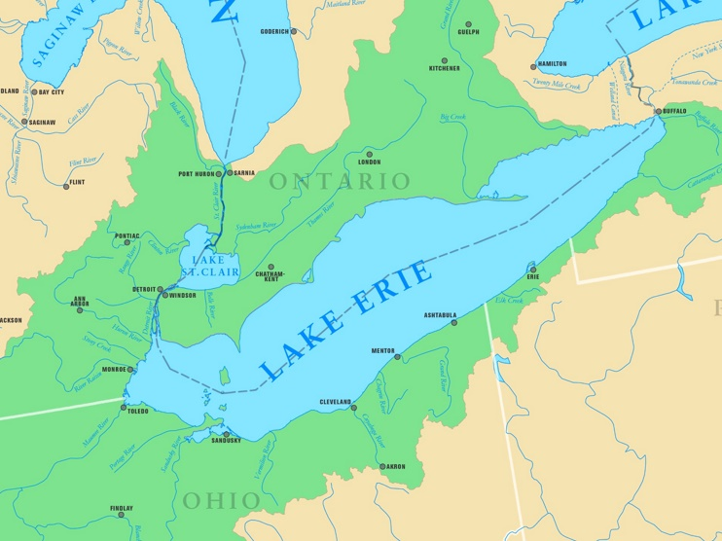
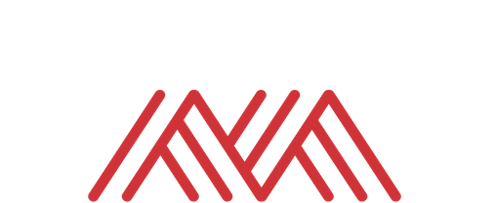
👋
http://ontheworldmap.com/usa/lake/lake-erie/map-of-lake-erie-with-cities-and-rivers.html
Notes:
Ok, let’s end our EDA module on the Central Limit Theorem as you’ll see it’s the “missing link” between descriptive and inferential statistics.
We are done with the first module! Any questions?

Slide 4
OBJECTIVES FOR TODAY
Normality explained
Normality and statistical inference
Sampling and the margin of error
Frequentist versus Bayesian probability
Next steps for learning statistics
Learning Statistics in Excel
Notes:
Objectives for today – while we will get into some of the theory, I really want to frame what we are learning in the context of business application and know-how as possible.
So, you are able to explain in plain English the kinds of business questions that could be answered with a t-test. You can write a sound hypothesis. You can know how to size up a dataset to get a sense of the kinds of story the data can show.

Slide 5
PREREQUISITES
Familiarity with descriptive statistics (mean/median/mode, standard deviation/variance)
Experience with intermediate Excel functions (MATCH(), nested IF() statements, etc.)
Ability to insert and modify Excel charts
Learning Statistics in Excel
Notes:
Objectives for today – while we will get into some of the theory, I really want to frame what we are learning in the context of business application and know-how as possible.
So, you are able to explain in plain English the kinds of business questions that could be answered with a t-test. You can write a sound hypothesis. You can know how to size up a dataset to get a sense of the kinds of story the data can show.

Slide 6
FOLLOWING ALONG
Each section is a sub-folder
Demos = follow along with me
Refresh your memory with the demo notes
Learning Statistics in Excel
Notes:
This is an Excel class, so we won’t be looking at PowerPoint the whole time – to follow along, you will see that all assets are divided by section.
Some of our Excel time will be Demos – for this I will be walking through some procedure in Excel.
If you need any datasets they will be included in each sub-folder.
Then there may be a Drill where you will work on it for yourself during some specified period of time.
I have provided written notes/instructions about the Demos which you can refer to while working on the Drills.

Slide 7

WHY WOULD WE DO THIS IN EXCEL?
“You get to look at the data every step of the way, building confidence while learning the tricks of the trade.”
-- John Foreman
Excel Statistics for Business Analytics
Notes:
With the rise of data science programming in R and Python it seems silly to want to do this in Excel but we can really get hands-on this way. We get a lot more up close and personal analysis of the data.

Slide 8
1. NORMALITY EXPLAINED
Notes:
Let’s begin with Exploratory Data Analysis in Excel.
Pulse check – who has heard of this term before and how would you define it? Or outside of defining it, what are some examples of it?

Slide 9
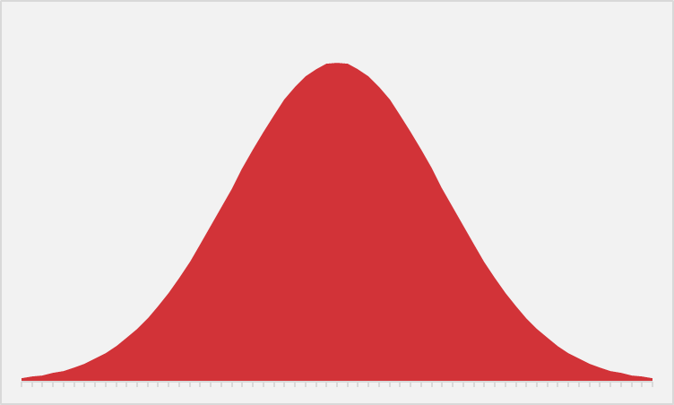
EVER WANTED TO JUST BE NORMAL?
STATISTICS IS YOUR CHANCE.
Notes:
The normal distribution of paramount in statistics. We are able to extrapolate pretty well about a variable’s value when it falls on a bell curve because we know exactly how “spread” the variable’s values are around its center.
Next slide for some specifics.

Slide 10
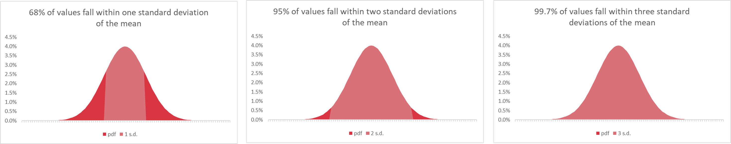
WHAT DOES IT MEAN TO BE NORMAL?
“Empirical rule”
Notes:
This is called the empirical rule and it tells us how many observations we expect to fall within how many standard deviations of the mean. We can expect that 68% of our observations fall within 1 standard deviation, 95% within 2, and 99.7% within 3. This allows us to state how likely or unlikely it is to get any certain value.

Slide 11
DEMO
Demo: empirical-rule.xlsx
Probability density function : tells us what percent of values we expect to find within a given interval of a distribution
e.g. We would expect to find about 2% of values ranging between 34 and 42 for a normally-distributed variable with a mean of 50 and standard deviation of 10
Notes:
Let’s take an example here, and don’t forget about the demo notes!

Slide 12
QUESTIONS?
Notes:
Ok, let’s end our EDA module on the Central Limit Theorem as you’ll see it’s the “missing link” between descriptive and inferential statistics.
We are done with the first module! Any questions?

Slide 13
2. NORMALITY AND STATISTICAL INFERENCE
Notes:
Let’s begin with Exploratory Data Analysis in Excel.
Pulse check – who has heard of this term before and how would you define it? Or outside of defining it, what are some examples of it?

Slide 14

STATROULETTE
A roulette wheel returns values between 0 and 36.
Let’s simulate a game of roulette in Excel
Notes:
Instructions follow on the next slide.

Slide 15
DEMO
central-limit.xlsx
First:
Simulate 500 rounds of a roulette spin.
Plot the resulting frequency distribution as a histogram.
Then:
Simulate a roulette spin 100 times.
Take the average spin.
Do this for 500 trials.
Plot the distribution of trial means as a histogram.
Notes:
More instructions on next slide.
Ask if anyone knows what formula to use for this.

Slide 16

MAGIC… OR STATISTICS?
Central limit theorem: the sampling distribution of the mean of any independent, random variable will be normal or nearly normal, if the sample size is large enough.
Notes:
Magic, or statistics? This is courtesy of the central limit theorem. Sample means tend to normality, which means since we know the probability distribution, we can make reliable estimates about a population, given a sample, as we extrapolate to that population.

Slide 17
How “large enough” is large enough?
N = 30? 60? 100?
It depends on how “normal” your sample is
Notes:
The big caveat is that a sample has to be “large enough.” What does that mean? Well, the base case is 30. 60 is better and 100 is even better. If your data’s sample is already looking normal, it’s going to take a smaller sample size to hit that “large enough” qualification. So generally a normally distributed variable is considered a requirement to do these statistics in practice, whereas in theory this is not such a dead-locked requirement.

Slide 18
DEMO
large-numbers.xlsx
A roulette wheel returns values between 0 and 36.
What is the average roulette spin given more and more spins?

Slide 19
MAGIC… OR STATISTICS?
Law of large numbers: the average of results obtained from trials become closer to the expected value as more trials are performed
Notes:
Magic, or statistics?

Slide 20
QUESTIONS?
Notes:
Ok, let’s end our EDA module on the Central Limit Theorem as you’ll see it’s the “missing link” between descriptive and inferential statistics.
We are done with the first module! Any questions?

Slide 21
3. SAMPLING AND THE MARGIN OF ERROR
Notes:
Let’s begin with Exploratory Data Analysis in Excel.
Pulse check – who has heard of this term before and how would you define it? Or outside of defining it, what are some examples of it?

Slide 22

DEMO
File: margin-of-error.xlsx
Pollsters often report a “margin of error of +/- 2-3%.”
What does that mean?
Notes:
We will continue in our analysis of air conditioning & prices, again the confidence interval is not included with the ToolPak so we will have to crunch these numbers ourselves.

Slide 23
QUESTIONS?
Notes:
Ok, let’s end our EDA module on the Central Limit Theorem as you’ll see it’s the “missing link” between descriptive and inferential statistics.
We are done with the first module! Any questions?

Slide 24
4. FREQUENTIST AND BAYESIAN PROBABILITY
Notes:
In this module we will begin to take what we’ve learned about our sample data, and how sample means behave, and put those together to start making inferences about a population based on a sample.

Slide 25
Statistical concept | Frequentist
Variables | Random and deterministic
Parameters | Fixed, unknown constants
Estimators | Should be good when averaged across many trials
Notes:
This is called the empirical rule and it tells us how many observations we expect to fall within how many standard deviations of the mean. We can expect that 68% of our observations fall within 1 standard deviation, 95% within 2, and 99.7% within 3. This allows us to state how likely or unlikely it is to get any certain value.

Slide 26
Notes:
This is called the empirical rule and it tells us how many observations we expect to fall within how many standard deviations of the mean. We can expect that 68% of our observations fall within 1 standard deviation, 95% within 2, and 99.7% within 3. This allows us to state how likely or unlikely it is to get any certain value.

Slide 27
Notes:
This is called the empirical rule and it tells us how many observations we expect to fall within how many standard deviations of the mean. We can expect that 68% of our observations fall within 1 standard deviation, 95% within 2, and 99.7% within 3. This allows us to state how likely or unlikely it is to get any certain value.

Slide 28
DEMO
monty-hall.xlsx
Three doors: one car, two goats
You pick a door
Monty opens another door: it has a goat
Do you stick to your door, or switch doors? Does it matter?
🚪🚪🚪
🐐🚗🐐

Slide 29
https://www.youtube.com/watch?v=4Lb-6rxZxx0
Notes:
This is called the empirical rule and it tells us how many observations we expect to fall within how many standard deviations of the mean. We can expect that 68% of our observations fall within 1 standard deviation, 95% within 2, and 99.7% within 3. This allows us to state how likely or unlikely it is to get any certain value.

Slide 30
Statistical concept | Frequentist | Bayesian
Variables | Random and deterministic | Everything is random
Parameters | Fixed, unknown constants | Subjective belief
Estimators | Should be good when averaged across many trials | Should be good for the available data
Notes:
This is called the empirical rule and it tells us how many observations we expect to fall within how many standard deviations of the mean. We can expect that 68% of our observations fall within 1 standard deviation, 95% within 2, and 99.7% within 3. This allows us to state how likely or unlikely it is to get any certain value.

Slide 31
QUESTIONS?
Notes:
Ok, let’s end our EDA module on the Central Limit Theorem as you’ll see it’s the “missing link” between descriptive and inferential statistics.
We are done with the first module! Any questions?

Slide 32
4. CONCLUSION

Slide 33
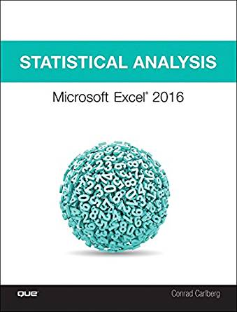
Statistical Analysis: Microsoft Excel 2016, by Conrad Carlberg
On O’Reilly Learning at https://learning.oreilly.com/library/view/statistical-analysis-microsoft/9780134840437/
Human Centered Design • MDLS 2020
Notes:
First, this is a pretty comprehensive look at doing statistics in Excel, this will indeed take you all the way through into linear regression, using Excel.

Slide 34
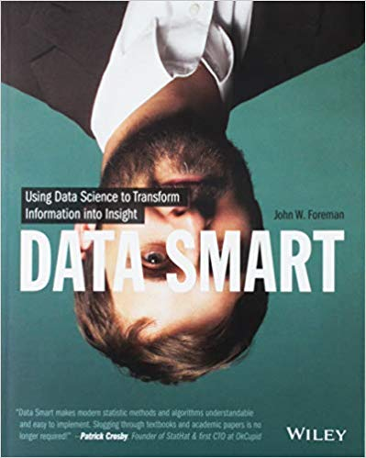
Data Smart: Using Data Science to Transform Information into Insight,
by John Foreman
On O’Reilly Learning at https://learning.oreilly.com/library/view/data-smart-using/9781118661468/
Human Centered Design • MDLS 2020
Notes:
This is a more “modern” approach to statistical analysis in Excel and will show you techniques like clustering, naïve Bayes, and things that you might not have thought possible in Excel, but again by learning them in Excel you get a really hands-on look at how these algorithms work that you may not necessarily get in R or Python (I quoted from this book way at the beginning in explaining why we would want to learn this stuff in Excel!)
The final chapter of this book does show you how to move into R from spreadsheets which is not a bad idea when you want to “productionize” what you have learned, but spreadsheets are really an awesome learning tool.

Slide 35

Stringfest Analytics Resource Library
stringfestanalytics.com
Human Centered Design • MDLS 2020
Notes:
Here is something I have come up with on my website, it’s a resource library for teaching data analytics. I have things like lesson plans and white papers, etc. Take a look and I hope it helps you. My idea is to essentially open-source what a data analytics training academy would look like for an organization.

Slide 36
LET'S TALK
LINKEDIN
linkedin.com/in/gjmount
EMAIL ADDRESS
george@stringfestanalytics.com
WEBSITE
stringfestanalytics.com
GITHUB
github.com/summerofgeorge
Notes:
Thanks for coming! Feel free to contact me anytime, find me on LinkedIn, I also write frequently on this stuff so check out my website too.

Slide 37
QUESTIONS?
Notes:
Any final questions?

